Slide 1
Chapter 3. Decompositions of graphs

Slide 2
Why graphs?
A wide range of problems can be expressed with clarity and precision in the concise pictorial language of graphs.
Graph coloring
Graph connectivity and reachability.
Flow.
Formally, a graph is speciﬁed by a set of vertices (also called nodes) V and by edges E between select pairs of vertices.
Undirected graphs, i.e., E is a symmetric relation.
Directed graphs.

Slide 3
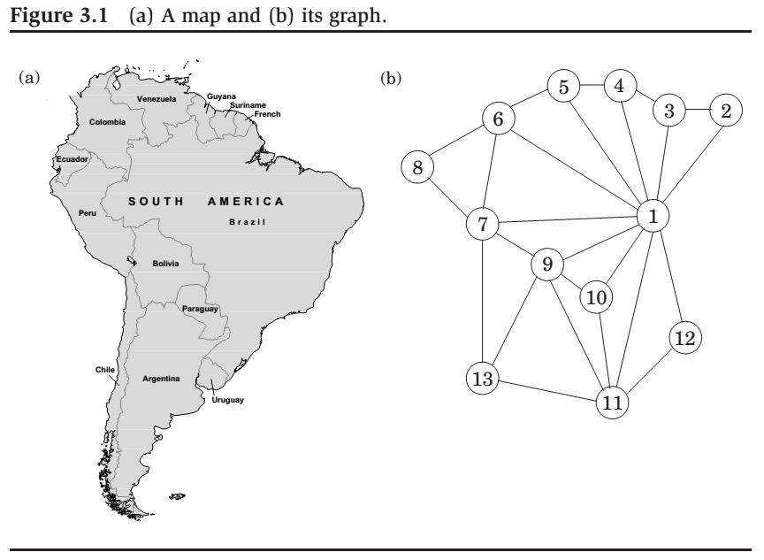

Slide 4
How is a graph represented?
We can represent a graph by an adjacency matrix: if there are n = |V| vertices v₁,...,v_{n}, this is an n×n array whose (i,j)th entry is
1
0
if there is an edge from v_{i} to v_{j}
otherwise.
aij =
For undirected graph, the matrix is symmetric since an edge {u, v} can betaken in either direction.
Pros: the presence of a particular edge can be checked in constant time, with just one memory access.
Cons: Takes up O(n²) space, which is wasteful if the graph does not have very many edges.

Slide 5
How is a graph represented? (cont’d)
We can represent a graph by an adjacency list: It consists of |V| linked lists, one per vertex.
The linked list for vertex u holds the names of vertices to which u has an outgoing edge – that is – vertices v for which (u,v)∈E.
Therefore, each edge appears in exactly one of the linked lists if the graph is directed or two of the lists if the graph is undirected.
Pros: The total size of the data structure is O(|E|).
Cons: Checking for a particular edge (u, v) is no longer constant time.

Slide 6
Depth-ﬁrst search in undirected graphs

Slide 7
The basic question
Question:
What parts of the graph are reachable from a given vertex?

Slide 8
Exploring graphs
explore(G, v)
Input: G = (V, E) is a graph; v ∈ V
Output: visited(u) is set to true for all nodes u reachable from v
visited(v) = true
previst(v)
for each edge (v, u) ∈ E do
if not visited(u) then explore(u)
postvisit(v)
previsit and postvisit procedures are optional, meant for performing operations on a vertex when it is ﬁrst discovered and also when it is being left for the last time.

Slide 9
Exploring graphs (cont’d)
Theorem
explore(G, v) is correct, i.e., it visits exactly all nodes that are reachable from v.
Proof
Every node which it visits must be reachable from v:
explore only moves from nodes to their neighbors and can therefore never jump to a region that is not reachable from v.
Every node which is reachable from v must be visited eventually:
If there is some u that explore misses, choose any path from v to u, and look at the last vertex z on that path that the procedure actually visited. Let w be the node immediately after it on the same path.
So z was visited but w was not. This is a contradiction: while explore was at node z, it would have noticed w and moved on to it.

Slide 10
Edge types
Those edges in G that are traversed by explore are tree edges.
The rest are back edges.

Slide 11
Depth-ﬁrst search (DFS)
DFS(G)
for all v ∈ V do
visited(v) = false
for all v ∈ V do
if not visited(v) then explore(v)

Slide 12
Running time of DFS
Because of the visited array, each vertex is explore’d just once.
During the exploration of a vertex, there are the following steps:
1. Some ﬁxed amount of work – marking the spot as visited,
and the pre/postvisit.
A loop in which adjacent edges are scanned, to see if they lead
somewhere new.
This loop takes a diﬀerent amount of time for each vertex. The total work done in step 1 is then O(|V|).
In step 2, over the course of the entire DFS,
each edge {x, y} ∈ E is examined exactly twice, once during explore(x) and once during explore(y).
The overall time for step 2 is therefore O(|E|) and so the depth-ﬁrst search has a running time of O(|V| + |E|).

Slide 13
Connectivity in undirected graphs
Deﬁnition
An undirected graph is connected, if there is a path between any pair of vertices.
Deﬁnition
A connected component is a subgraph that is internally connected
but has no edges to the remaining vertices.
When explore is started at a particular vertex, it identiﬁes precisely
the connected component containing that vertex.
Each time the DFS outer loop calls explore, a new connected component is picked out.

Slide 14
Connectivity in undirected graphs (cont’d)
Thus depth-ﬁrst search is trivially adapted to check if a graph is connected.
More generally, to assign each node v an integer ccnum[v] identifying the connected component to which it belongs.
All it takes is
previsit (v)
ccnum[v] = cc
where cc needs to be initialized to zero and to be incremented each time the DFS procedure calls explore.

Slide 15
Previsit and postvisit orderings
For each node, we will note down the times of two important events:
the moment of ﬁrst discovery (corresponding to previsit); and the moment of ﬁnal departure (postvisit).
previsit(v)
pre[v] = clock
clock = clock + 1
postvisit(v)
post[v] = clock
clock = clock + 1
Lemma
For any nodes u and v, the two intervals [pre(u),post(u)] and
[pre(v),post(v)] are either disjoint or one is contained within the other.

Slide 16
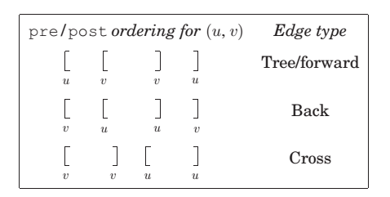
Types of edges (cont’d)
pre/post ordering for (u,v)
Edge type
[u
[v
[v
[v
[u
]v
]v
]u
[u
]u
]v
]u
Tree/forward
Back
Cross

Slide 17
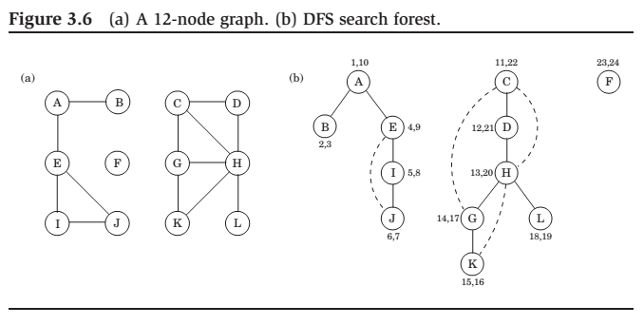
DFS

Slide 18
Depth-ﬁrst search in directed graphs

Slide 19
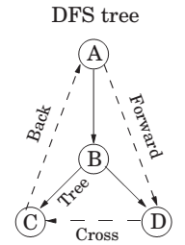
Types of edges
DFS yields a search tree/forests.
root
descendant and ancestor.
parent and child.
Tree edges are actually part of the DFS forest.
Forward edges lead from a node to a nonchild descendant in the DFS tree.
Backedges lead to an ancestor in the DFS tree.
Cross edges lead to neither descendant nor ancestor; they therefore lead to a node that has already been completely explored (that is, already post visited).

Slide 20
Directed acyclic graphs (DAG)
Deﬁnition
A cycle in a directed graph is a circular path
v₀ → v₁ → v₂ → ···v_{k} → v₀.
Lemma
A directed graph has a cycle if and only if its depth-ﬁrst search reveals a back edge.
Proof.
One direction is quite easy: if (u, v) is a back edge, then there is a cycle consisting of this edge together with the path from v to u in the search tree.
Conversely, if the graph has a cycle v₀ → v₁ → v₂ → ···v_{k} → v₀, look at the ﬁrst node v_{i} on this cycle to be discovered (the node with the lowest prenumber). All the other v_{j} on the cycle are reachable from it and will therefore be its descendants in the search tree. In particular, the edge v_{i -1} → v_{i} (or v_{k} → v₀ if i = 0) is a back edge.

Slide 21
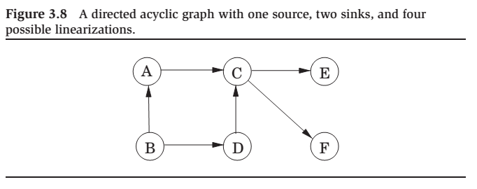

Slide 22
Directed acyclic graphs (cont’d)
Linearization/Topologically Sort: Order the vertices such that every edge
goes from a small vertex to a large one.
Lemma
In a DAG, every edge leads to a vertex with a lower post number.
Hence there is a linear-time algorithm for ordering the nodes of a DAG.
Since a DAG is linearized by decreasing post numbers, the vertex with the
smallest post number comes last in this linearization, and it must be a sink –
no outgoing edges. Symmetrically, the one with the highest post is a
source, a node with no incoming edges.
Lemma
Every DAG has at least one source and at least one sink.
The guaranteed existence of a source suggests an alternative approach to
linearization:
1. Find a source, output it, and delete it from the graph.
2. Repeat until the graph is empty.

Slide 23
Strongly connected components

Slide 24
Deﬁning connectivity for directed graphs
Deﬁnition
Two nodes u and v of a directed graph are connected if there is a path from u to v and a path from v to u.
This relation partitions V into disjoint sets that we call strongly connected components.
Lemma
Every directed graph is a DAG of its strongly connected components.

Slide 25
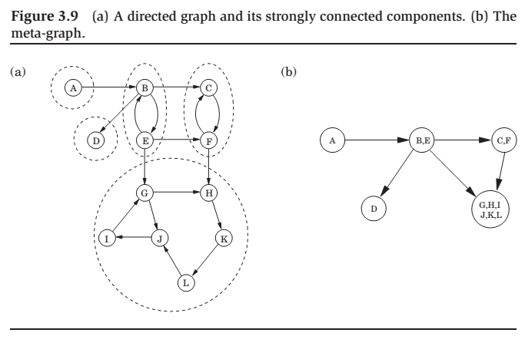

Slide 26
An eﬃcient algorithm
Lemma
If the explore subroutine is started at node u, then it will terminate precisely when all nodes reachable from u have been visited.
Therefore, if we call explore on a node that lies somewhere in a sink strongly connected component (a strongly connected component that is a sink in the meta-graph), then we will retrieve exactly that component.
We have two problems:
How do we ﬁnd a node that we know for sure lies in a sink
strongly connected component?
(B) How do we continue once this ﬁrst component has been discovered?

Slide 27
An eﬃcient algorithm (cont’d)
Lemma
The node that receives the highest post number in a depth-ﬁrst search must lie in a source strongly connected component.
Lemma
If C and C’ are strongly connected components, and there is an edge from a node in C to a node in C’, then the highest post number in C is bigger than the highest post number in C’.
Hence the strongly connected components can be linearized by arranging them in decreasing order of their highest post numbers.

Slide 28
Solving problem A
Consider the reverse graph GR, the same as G but with all edges reversed. GR has exactly the same strongly connected components as G.
So, if we do a depth-ﬁrst search of GR, the node with the highest post number will come from a source strongly connected component in GR, which is to say a sink strongly connected component in G.

Slide 29
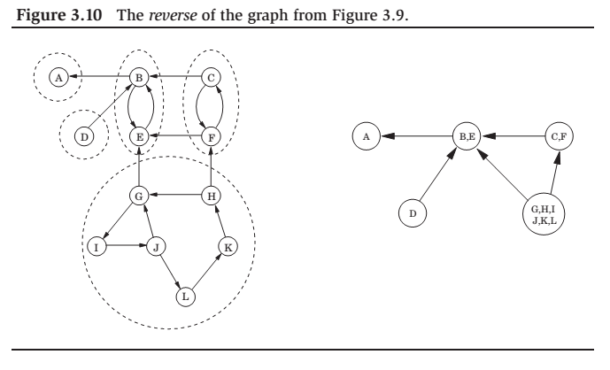

Slide 30
Solving problem B
Once we have found the ﬁrst strongly connected component and deleted it from the graph, the node with the highest post number among those remaining will belong to a sink strongly connected component of whatever remains of G.
Therefore we can keep using the post numbering from our initial depth-ﬁrst search on GR to successively output the second strongly connected component, the third strongly connected component, and so on.

Slide 31
The linear-time algorithm
1. Run depth-ﬁrst search on GR.
Run the undirected connected components algorithm on G, and during the depth-ﬁrst search, process the vertices in decreasing order of their post numbers from step 1.

